Slide 1
Lecture 1
Introduction, Linear Regression, Logistic Regression

Slide 2
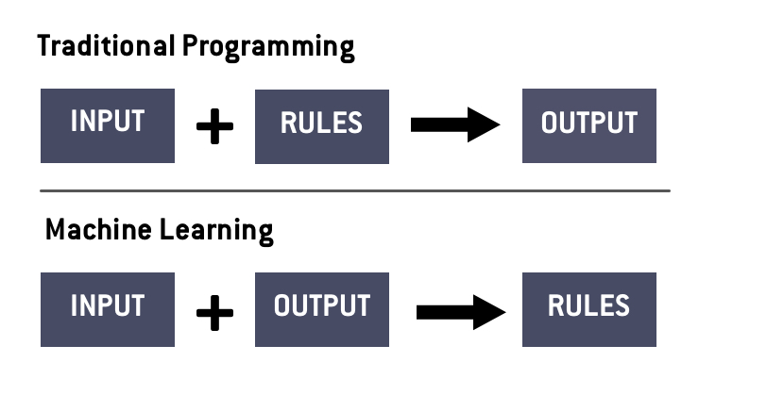
Introduction
Machine learning is all about finding trends in data, and extrapolating those trends for real world solutions. The goal is to make a model “learn” by giving it data, making it take a “guess”, and correcting its “learning” based on that guess

Slide 3
Types of Machine Learning
There are many different forms of machine learning, but the main two superclasses are
Supervised Learning
You are given the input and the output, and your goal is to determine the correlation. Working with labelled data
Unsupervised Learning
You are given the input, and the goal is to cluster or group this input. The data does not have a given label and your goal is to more determine the labels

Slide 4
Train/Validate/Test
The main process for a standard supervised learning model comes in three steps
Train - This is the process where the model “learns”. The input data is given to the model, and it processes this data row by row, produces an output, compares this output to the expected output, and updates the parameters of the model
Validate - This is the part of the dataset that is used to determine how well the model is doing during training. It is not used to adjust the parameters, but instead more global variables such as how fast we train or how big of a jump we make in minimizing
Test - This is unseen data that is used to evaluate the model. In literature, the accuracy or score of this model is the one reported and used as the “true” performance of the model

Slide 5
Linear Regression

Slide 6
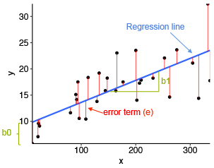
Linear Regression
Fitting the best fit line to a dataset of one or more variables
Implies there is only one output
Simple Linear Regression
𝑦 = 𝑏₀ + 𝑏₁𝑥
Multivariable Linear Regression
Same idea with more input variables and thus more variables

Slide 7
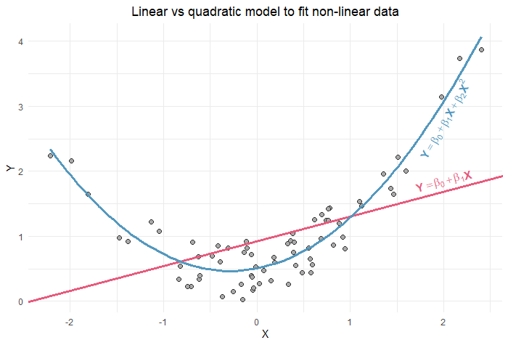
What if the data is like this?

Slide 8
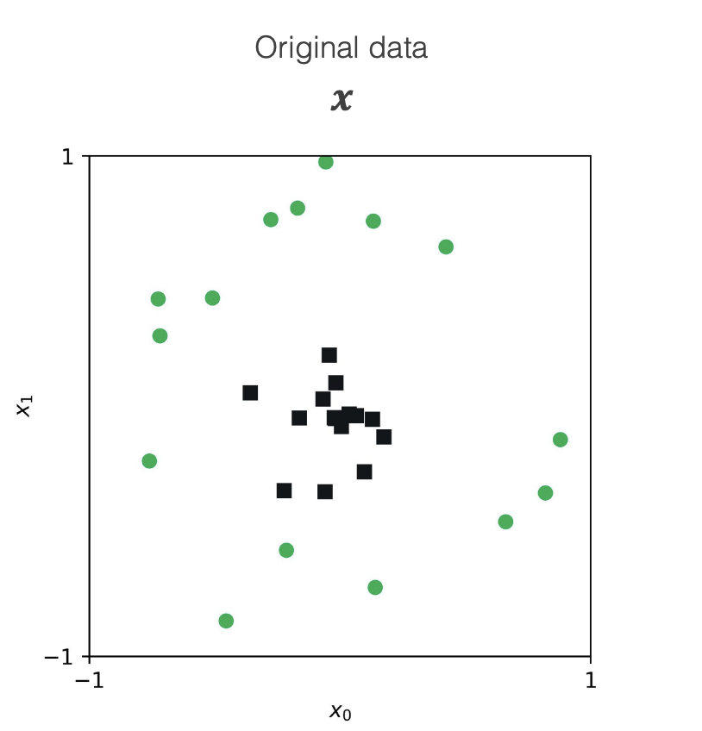
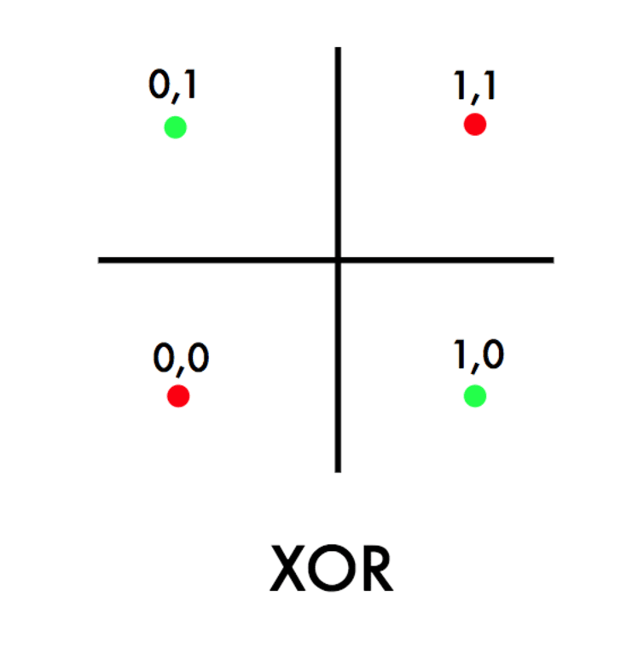
Where Linear Regression Fails

Slide 9
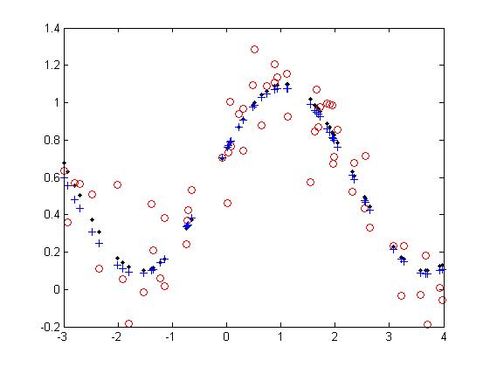
Introduce New Variables!
If the data is quadratic, square all your inputs, and create another column of squared elements
𝑦 = 𝑏₀ + 𝑏₁𝑥 + 𝑏₂𝑥²
Polynomial Regression
Trigonometric Regression

Slide 10
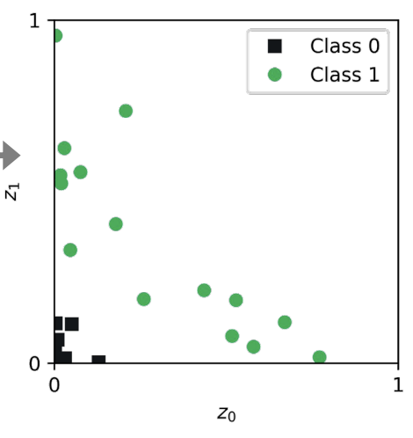
Looking at our previous example

Slide 11
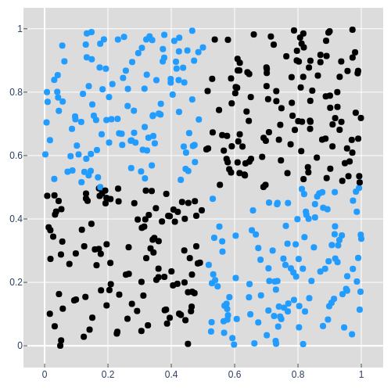
What about this graph?
Notes:
Q1 = (x0 > 0.5) && (x1 > 0.5) → Black (Y = 1)
Q3 = (x0 < 0.5) && (x1 < 0.5) → Black (Y = 1)
Y = Q1 + Q3

Slide 12
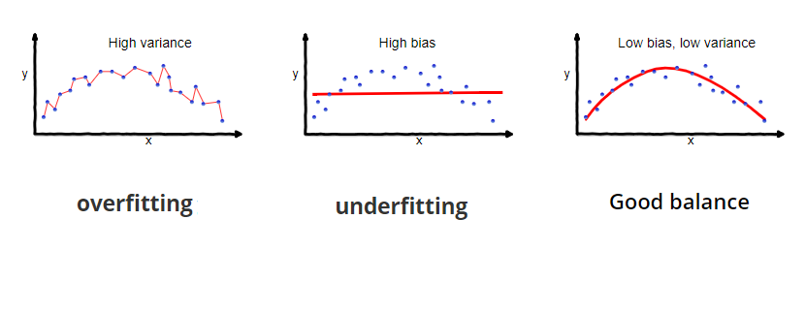
Be Careful About Overfitting
If we add too many terms, we can overfit to the train data, making too many assumptions that are not justified. This might potentially give us bad results on the test data since we made incorrect assumptions

Slide 13
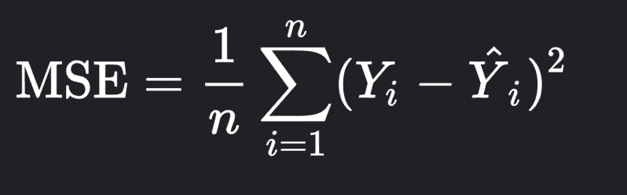
Evaluating the Model
Loss Function - Mean Squared Error
Take the difference between every predicted y value and actual y value, square that difference, take the average of the differences
Our Goal - Minimize this Loss!
Next Lecture!

Slide 14
Logistic Regression

Slide 15
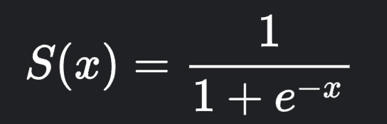
The Simplest Classification Model
The logistic regression model outputs two values: 0 and 1 - based on the classification
For a more classifications, the model outputs an array of numbers between 0 and 1 based on the probability of each classification
Sigmoid Function
Let z = wx + b where x is our input variable
Apply the sigmoid function on S(z)
Provides a value in between 0 and 1
If greater than 0.5 (or some boundary you decide), classify as 1 else 0

Slide 16
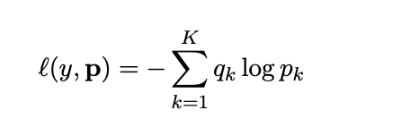
Cost Function
The cost function is defined as follows for a simple logistic regression
If Y = 1 (expected value), then the cost is -log(S(z))
If Y = 0 (expected value), then the cost is -log(1-S(z))
Cross Entropy Loss
The previous example was the cross entropy loss with only two possible classifications
With more classifications, the formula is as follows

Slide 17

Working with the Notebooks
We recommend doing everything locally (easier)
Install Anaconda (https://www.anaconda.com/)
conda create -n catalystworkshop python=3.7
conda activate catalystworkshop
pip install -r requirements.txt

Slide 18
Remember:
All Sci-Kit Learn classifiers follow the same pattern:
from sklearn.something import SomeClassifier
clf = SomeClassifier(parameter_1=xyz, parameter_2=abc)
clf.fit(X_train, y_train)
y_predicted = clf.predict(X_test)
print(accuracy_score(y_predicted, y_test))

Slide 19
Setup commands
pip install notebook # jupyter notebook
pip install numpy scipy pandas sklearn # ML tools
jupyter notebook # start the notebook

